Slide 1
BuzzStream
Gabriel A. Lopez Lugo, Huan Xu

Slide 2
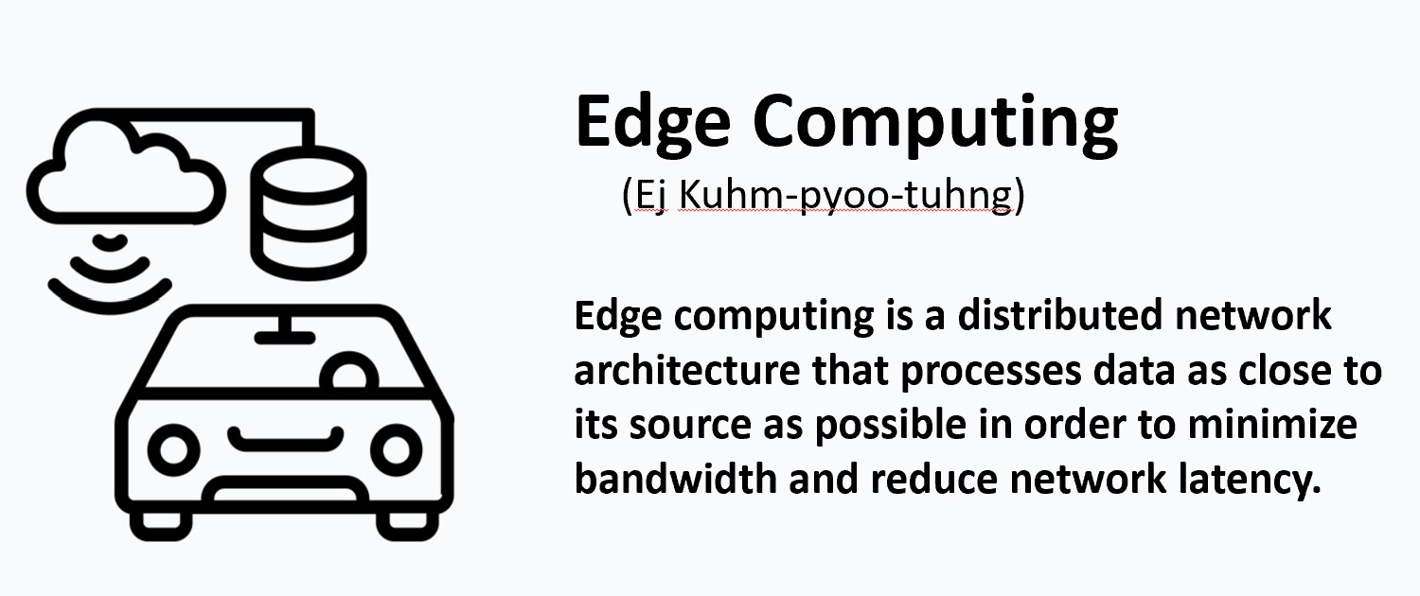
Motivation
New trends and challenges toward an edge computing future
Server-side computing not feasible for certain scenarios, e.g., self-driving cars
Heterogeneity in edge device capacity - not all edge devices are built the same
The runtime system load also changes dynamically
Machine learning inference requires heterogeneous resources (e.g. GPU, AI accelerator)
Trends point towards edge-cloud collaboration for low latency applications

Slide 3
Motivation
New trends and challenges toward an edge computing future
Server-side computing not feasible for certain scenarios, e.g., self-driving cars
Heterogeneity in edge device capacity - not all edge devices are built the same
The runtime system load also changes dynamically
Machine learning inference requires heterogeneous resources (e.g. GPU, AI accelerator)
Trends point towards edge-cloud collaboration for low latency applications
However, there is a lack of open-source test bench for latency-accuracy tradeoff explorations of machine learning inference on edge.
For this project, we aim to build such a test bench for edge ML inference in the video streaming domain.

Slide 4
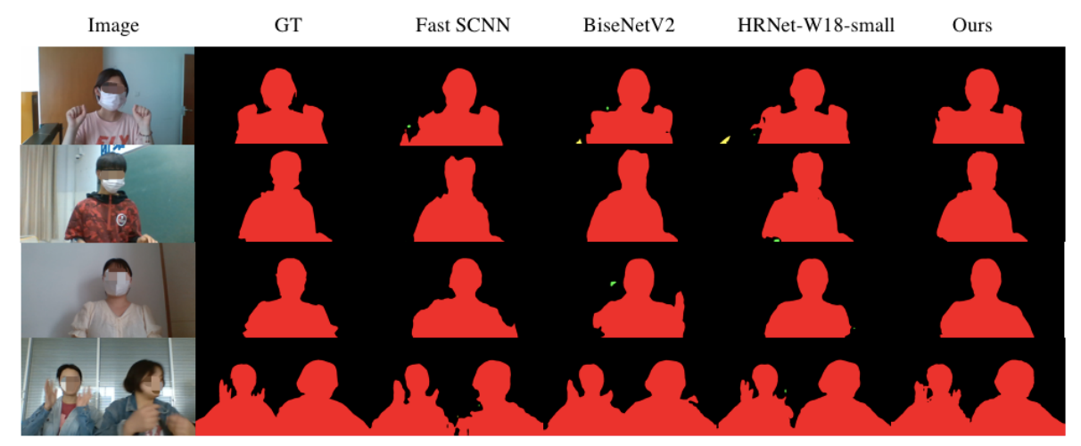
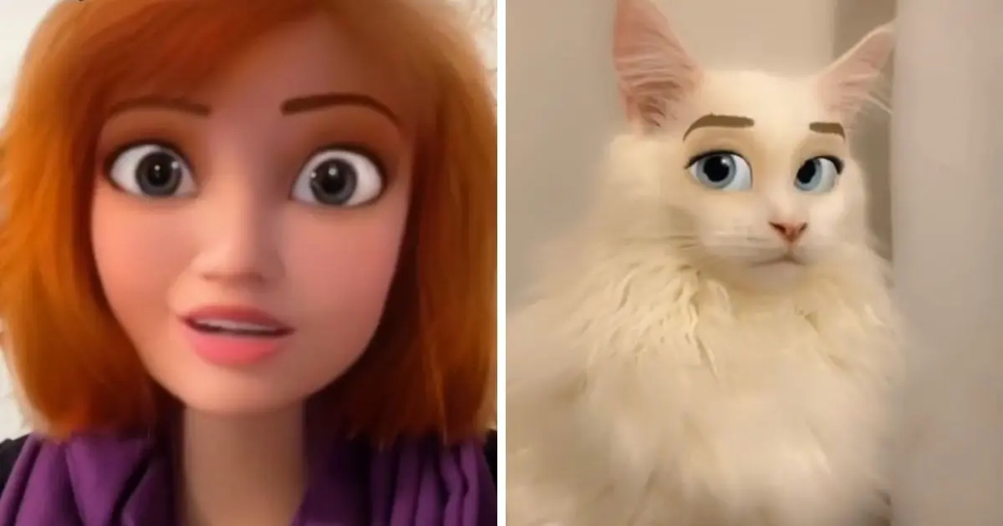
Why video streaming
During the COVID-19 pandemic, real-time video streaming software skyrocketed in demand and are largely still in use post-pandemic
Video streaming workloads are often coupled with real-time machine learning inference. For example, Snapchat’s cartoon filter and Zoom’s background removal
Video streaming applications can benefit from cloud + edge collaboration for lower latency
ML Workload 1: Image style transfer
ML Workload 2: Human segmentation

Slide 5
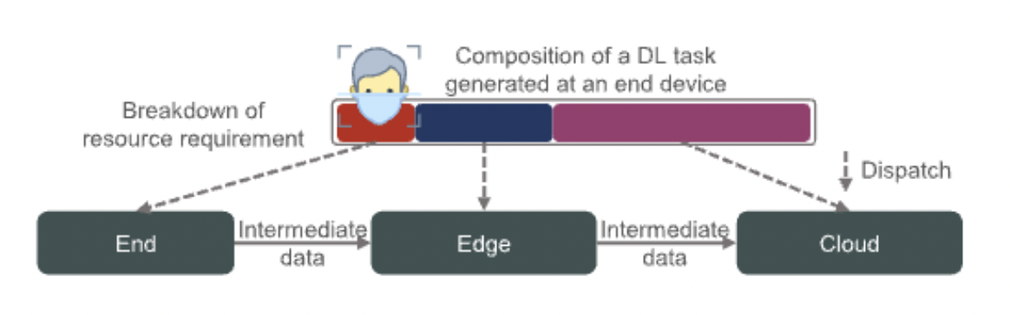
How can video streaming benefit from edge computing
Leaving inference to be done on the server instead of edge device while incur a latency of due to client and server round trips
Edge device removing background before forwarding the stream to cloud can save cloud processing time and potentially achieve lower latency
TikTok and other apps applying face-accurate filters while streaming

Slide 6

BuzzStream
Open-source solution for blending AI image processing features to live stream seamlessly to edge devices
Incorporates non-proprietary custom models to target specific devices
All in dynamic runtime environment
Runs in browser: no dedicated server required
We are a test bench:
Fast and lightweight
Can accept models compatible with paddle.js
Therefore, tensorflow or ONNX

Slide 7
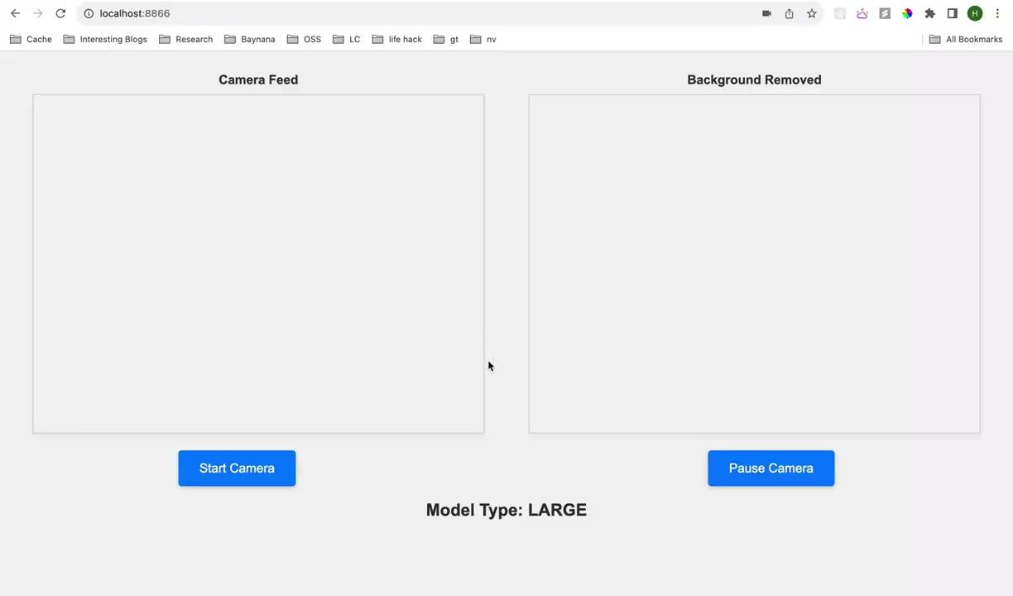
Demo - adaptive inference

Slide 8

Demo - adaptive inference with live stream

Slide 9
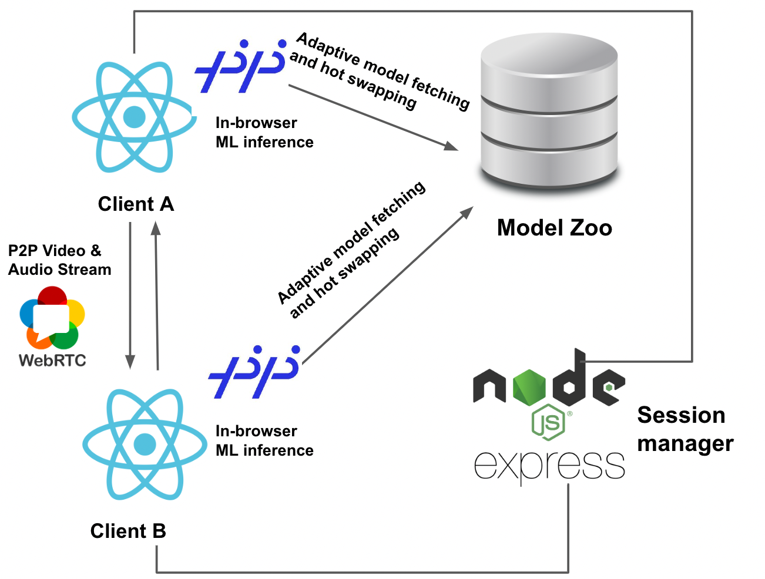
Architecture
Technologies
WebRTC
Paddle.js
socket.io
Node.js

Slide 10
Obstacles
Finding the right inference engine in browser: many options
E.g. tensorflow-js (only uses tf models), onnx runtime (slow), paddle.js (quite adaptive)
Finding an open-source base model
Full model is very slow (9 FPS),
Not trained for edge, won’t always work in browser
Distillation is required

Slide 11
Future Work
Explore more real-time video streaming settings
More popular as a meeting software
Cloud gaming
Aggregate model analytics to a database
Collect model inference analytical data as model properties
Match the best-performing model to a similar hardware spec

Slide 12
Future Work
General online model registers
We hardcoded the number of models and their properties
Only 3 models
Pre-labeled them with small, medium and large (one-dimensional view)
In reality, a model has multiple dimensions of properties, e.g.
Parameter size, quantization level, estimated power consumption, etc.
Ideally, the user can upload models to AWS S3, and the application will automatically pull models based on model properties and runtime environment

